Slide 1

BJIT ACADEMY
Appraisal
Software Design
Project Manager
Nani Gopal Bari, Md Kishor Morol
nani.gopal@bjitgroup.com
kishor.morol@bjitgroup.com
Niazi Mahrab
niazi.mahrab@bjitgroup.com
Office_id: 11301
Software Engineer at BJIT limited
Image Placeholder
Notes:
<number>

Slide 2
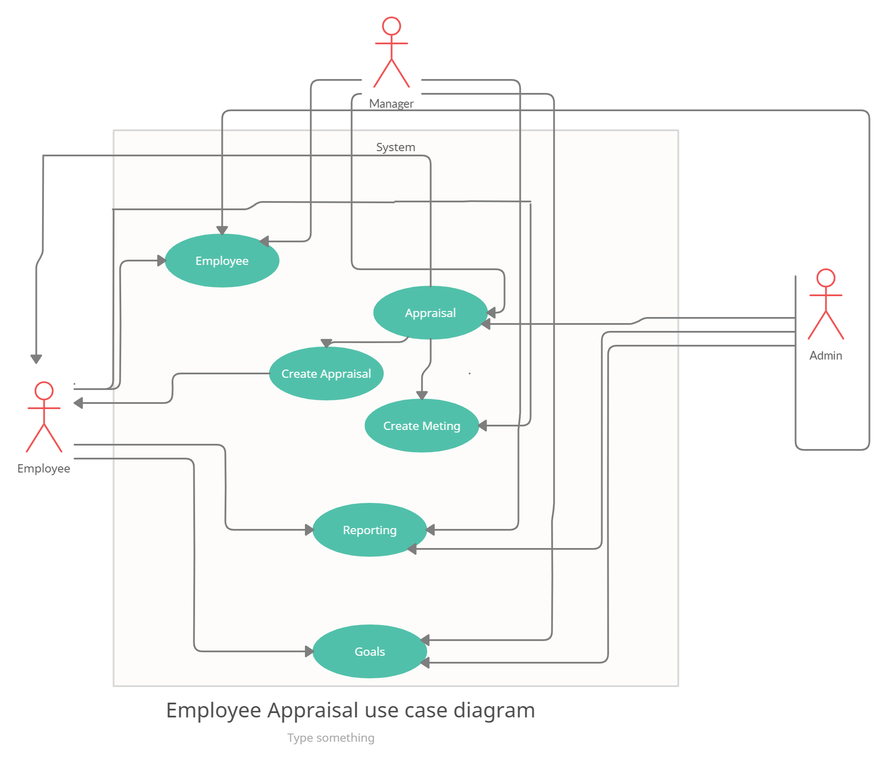
UML Diagrams
Use Case Diagram

Slide 3
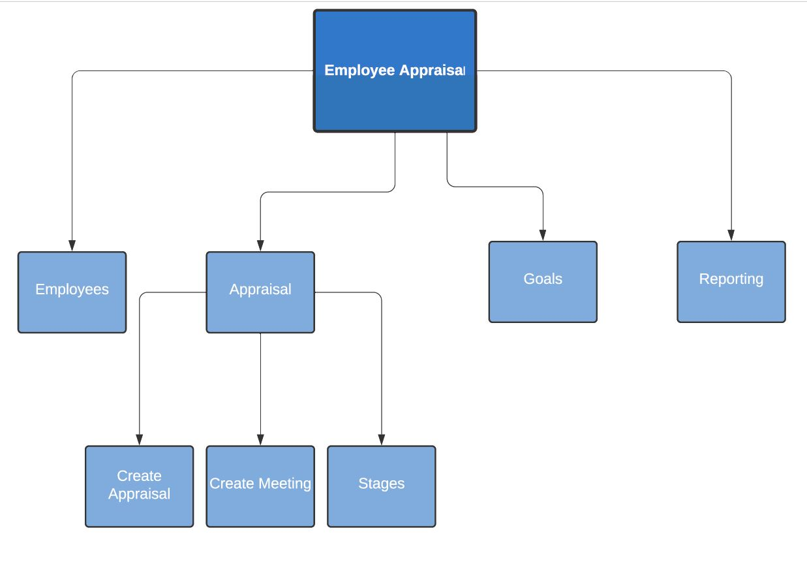
UML Diagrams
Structural Diagram

Slide 4
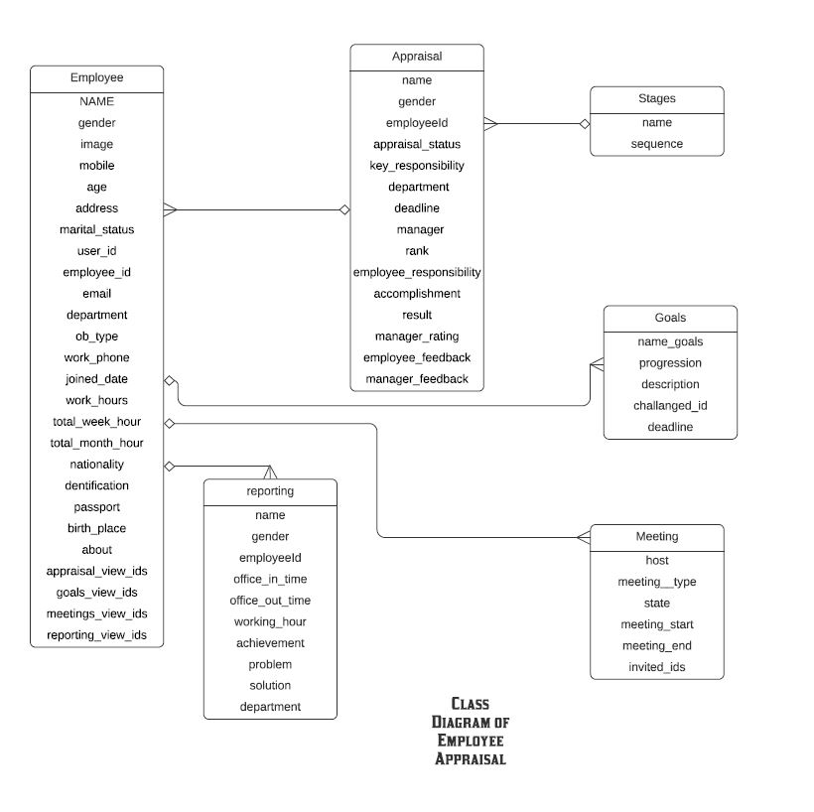
UML Diagrams
Class Diagram

Slide 5
Submission
29th October, 2021

Slide 6
Thank you

